Slide 1

House price Prediction using ML
- Aniket Keshri

Slide 2

Contents
Introduction
Problem statement
Problem Specification
Pipeline
DataSet
EDA
Tools and technology
Screenshots
Conclusions and Future Predictions

Slide 3

ABSTRACT
In this project, we have built a machine learning model to predict the house prices of a dummy city.
This project will very helpful for the real estate market.
Our model can be used by both house sellers and house buyers.
—Multiple Linear Regression algorithm is used to create model with a great accuracy score.

Slide 4

Problem statement
Price of real estate properties are directly linked with our economy.
Despite this we do not have accurate measures of house prices based on the vast amount of the data available
Proper and justified prices of properties can bring in a lot of transparency and trust back to the real estate industry .
Problem Specification
The goal of this project is to predict house prices in Dummy city based on some features such size/area, number of bedrooms, and number of bathrooms . Dummy house price dataset is used to create the model. We are using Machine Learning Algorithm to create a predictive model . Multiple Linear Regression algorithm is used to train and test the model in our project.

Slide 5
Pandas Libraries
Numpy
Python (Language).
SciKit Learn (IDE).
Jupyter NoteBook
Mathplotlib

Slide 6
Pipeline
Data cleaning(EDA)
Feature Engineering
Train a model
Interpretation
Data preprocessing

Slide 7

EDA The EDA is an adequate process to go through before applying a statistical model in order to: Understand the dataset Check if the data is missing Detect some outliers Add, transform or remove some features to get more out of the data

Slide 8
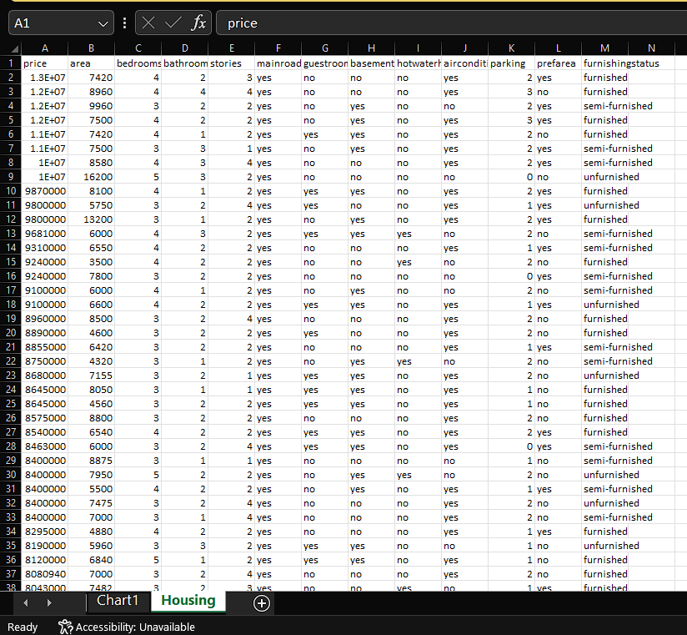
DATASET Dataset comes from kaggle.com. Link of the dataset https://www.kaggle.com/amitabhajoy/bengaluruchouse.price-data There are 576 number of observations in our dataset. There are a total of 13 columns/attributes in our dataset. The all 13 columns are area type, availability, location,size,total_sqft, bath, society, balcony, and price. We have used a total of 6 features to train our machine learning model.
Dataset

Slide 9
Feature engineering Feature engineering feature scaling Feature scaling facilitates gradient descent by making sure that the features are on the same scale. It makes it easier to find the local optimum. One technique to use is mean normalization. It replaces the target with (target-mean) to make sure the feature has approximately zero mean.
Pick and Train the Model
We will use linear regression for the sake of the project.
Usually, we run multiple models and choose the most appropriate ones depending on a different metric.
Linear regression as its related to machine learning is a type of supervised learning model in which the response is continuous.

Slide 10

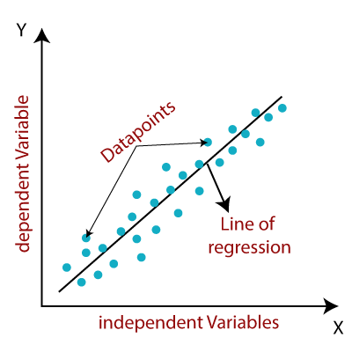
Train a model We have used linear regression for the sake of the project. Usually, we run multiple models and choose the most appropriate ones depending on a different metric. Linear regression as its related to machine learning is a type of supervised learning model in which the response is continuous. Form of linear regression: y= θX+θ1 or y= θ1+X1θ2 +X2θ3 + X3θ4 y is the target we want to predict θ is the coefficient X is the input We can see that the equation of our best fitted line is: 𝑝𝑟𝑖𝑐𝑒=0.35×𝑎𝑟𝑒𝑎+0.20×𝑏𝑎𝑡ℎ𝑟𝑜𝑜𝑚𝑠+0.19×𝑠𝑡𝑜𝑟𝑖𝑒𝑠+0.10×𝑎𝑖𝑟𝑐𝑜𝑛𝑑𝑖𝑡𝑖𝑜𝑛𝑖𝑛𝑔+0.10×𝑝𝑎𝑟𝑘𝑖𝑛𝑔+0.7×𝑝𝑟𝑒𝑓𝑎𝑟𝑒𝑎

Slide 11

Interpretation
We need an evaluation metric to evaluate if our hypothesis was correct. We will use the RMSE method.
Root Mean Square Error (RMSE) is the square root of the mean of square error. The error is the difference between the true and predicted values. It is often used because it is interpretable in the y-units which is in our case the median price of a house.

Slide 12
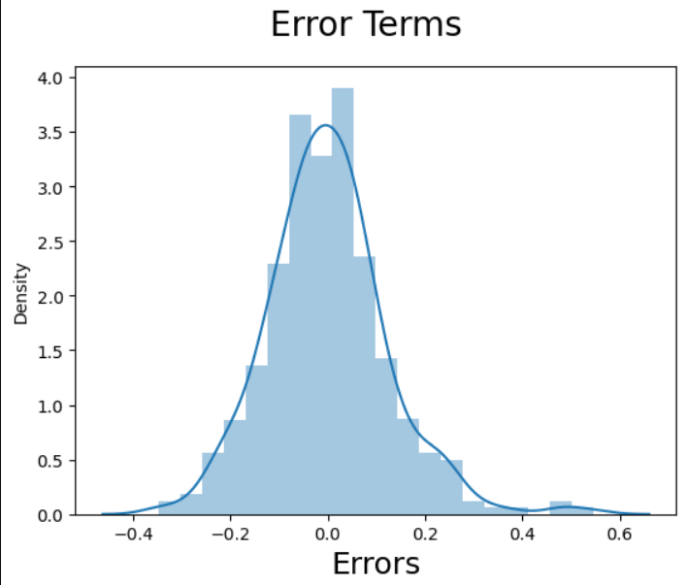
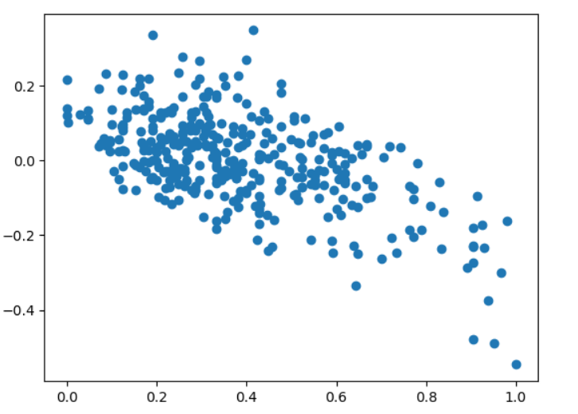
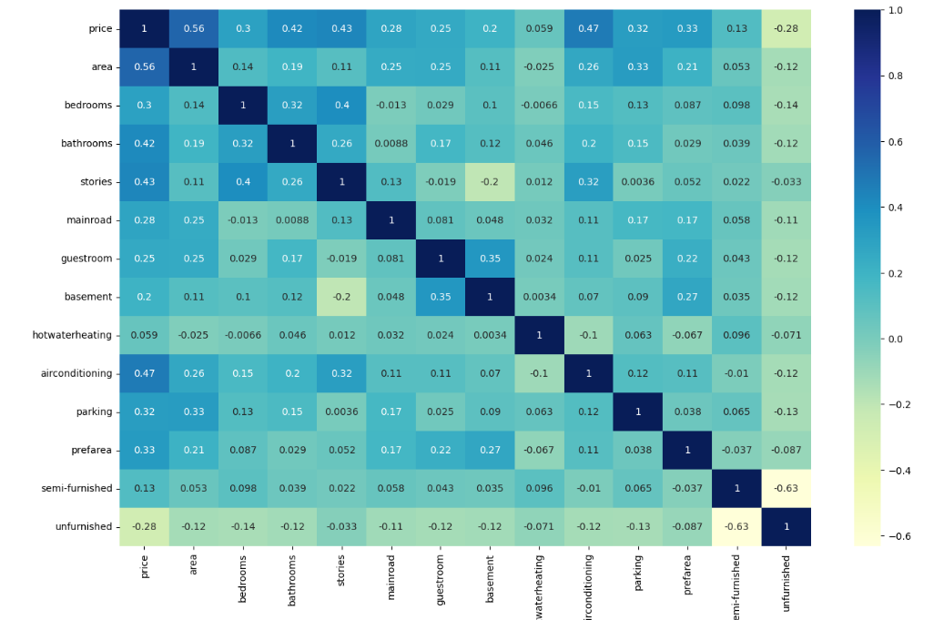
Screenshots

Slide 13

Future Work
Separately treating the outliers in some columns to have good distribution of the data.
Use regularization to keep all the features and reduce the magnitude of the parameters.
Improve the model by tweaking other parameters like alpha(learning parameters) and number of iterations.
Use the cross-validation instead of the train/test method to overcome high variance.
Create the linear regression from scratch using Python, NumPy, and pandas without Sklearn

Slide 14

THANK YOU!

